Slide 1

2018 Seminar on Predictive Modeling: Text Mining in Industry
Jeffrey Strickland, Ph.D., CMSP, ASEP
CEO Humalytica Analytics
Proprietor Simulation Educators

Slide 2
What is model scoring?
Definition
Example
Scoring is the process of generating real-time values by supplying predictive models with input data
Any artifact (i.e., scoring code) that can be used to produce output values given input data
Scoring code is generated in model post-processing requiring
Scoring data
Model variables (significant)
Model coefficients
Real-time
Latency
Availability
Static
Goodness of fit
Prediction accuracy (.i.e., > 70%)
Prediction consistency (i.e., out-of-time data set)
Dynamic
Time delay between cause and effect
Event-time correspondence
Representative distribution

Slide 3
Modeling SW and Scoring Models
SPSS Modeler
SAS Enterprise Guide (EG)/Miner (EM)
Models typys
Decision Tree
Regression
Clustering models
Generated
Single prediction
Associated probability
Confidence
Scoring graphs
Produced by EM
Optimized scoring code
Model package
XML file that contains metadata
ROC plot
EG Process
Import model package
Import scoring data
Generate scoring code if not using EM output
Customizable graphs & tables

Slide 4
R modeling and packages
R-Programing
R-Packages
Models with built-in or readily available scoring packages
GLM – Logistic regression
Classification trees
Cluster models
Measures/Metrics
Specificity / Sensitivity
Accuracy / Precision
Response function parsing
AUC (Auxiliary Code)
sqlscore (SQL Score)
ROCR (receiver operating characteristic)
Gains
scorer

Slide 5

Measures and Metrics
Specificity and Sensitivity
Accuracy and Precision
The ROC curve is a plot of 1-specificity against sensitivity
Affected by oversampling
True proportion of true positives $= π_{1}∗ sensitivity.$
True proportion of true negatives $= π_{0}∗ specificity$
True proportion of false positives $= π_{0}∗ \left(1 – specificity\right)$
True proportion of false negatives $= π_{1}∗ \left(1 – sensitivity\right)$
Precision is a positive predictive value
We use a 95% confidence interval (CI) to estimate the precision of the Odds Ratio.
A large CI indicates a low level of precision of the OR
A small CI indicates a higher precision of the OR.

Slide 6

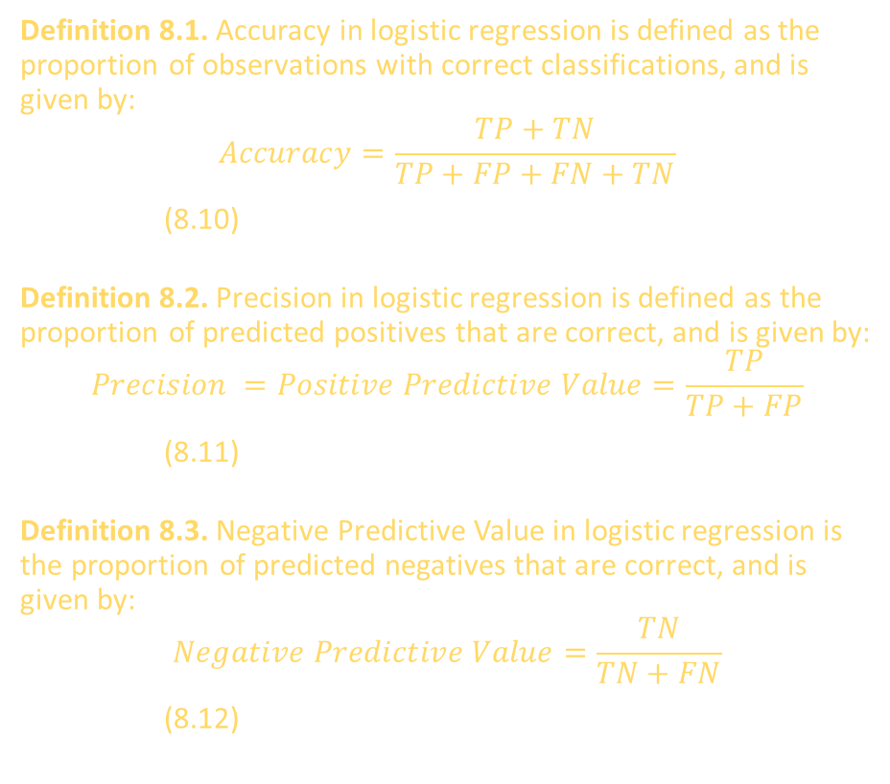
Definitions
Definition 8.1. Accuracy in logistic regression is defined as the proportion of observations with correct classifications, and is given by:
$$Accuracy=\frac{TP+TN}{TP+FP+FN+TN}$$
(8.10)
Definition 8.2. Precision in logistic regression is defined as the proportion of predicted positives that are correct, and is given by:
$$Precision =Positive Predictive Value=\frac{TP}{TP+FP}$$
(8.11)
Definition 8.3. Negative Predictive Value in logistic regression is the proportion of predicted negatives that are correct, and is given by:
$$Negative Predictive Value=\frac{TN}{TN+FN}$$
(8.12)
Definition 8.4. Sensitivity in logistic regression is defined as the proportion of observations that are actually positive with a correct predicted classification, and is given by:
$$Sensitivity=True Positive Rate=\frac{TP}{TP+FN}$$
(8.13)
Definition 8.5. Specificity in logistic regression is defined as the proportion of observations that are actually negative with a correct predicted classification, and is given by:
$$Specificity=True Negative Rate=\frac{TN}{TN+FP}$$
(8.14)

Slide 7
R packages
AUC (Axillary Code)
Sqlscore (SQL Score)
This package includes functions to compute the area under the curve (function auc) of selected measures
Area under the sensitivity curve (AUSEC) (function sensitivity),
Area under the specificity curve (AUSPC) (function specificity),
Area under the accuracy curve (AUACC) (function accuracy)
Area under the receiver operating characteristic curve (AUROC) (function roc).
Provides utilities for generating SQL queries (particularly CREATE TABLE statements) from R model objects
The most important use case is generating SQL to score a generalized linear model (glm) or related model represented as an R object
The package handles parsing formula operators and including the model's response function

Slide 8
R packages
ROCR (receiver operating characteristic)
gains
trade-off visualizations for specific pairs of performance measures
ROC graphs
sensitivity/specificity curves
lift charts
precision/recall plots
Constructs
gains tables for prediction algorithms
lift charts for prediction algorithms
Allows construction of:
Cumulative distribution function
Kolmogorov-Smirnov distribution
KS Test

Slide 9
R packages
pipeline
scoring (Proper Scoring Rules)
pipeliner package aims to provide an elegant solution to these issues by implementing a common interface and workflow with which it is possible to:
define transformation and inverse-transformation functions;
fit a model on training data; and then,
generate a prediction (or model-scoring) function
Evaluating probabilistic forecasts via proper scoring rules
scoring implements the beta, power, and pseudospherical families of proper scoring rules, along with ordered versions of the latter two families
Included among these families are popular rules like the Brier (quadratic) score, logarithmic score, and spherical score.
For two-alternative forecasts, also includes functionality for plotting scores that one would obtain under specific scoring rules.

Slide 10
R packages
scorer
User defined
A set of tools for quickly scoring models in data science and machine learning
Absolute error
Absoluter percent error
Mean absolute error
Total variance score
Etc.
Easy to program with a few lines of code
Build a R function
Create a R Package
Produce a Shiny Web App

Slide 11
Kolmogorov-Smirnov Test
Depth of File | N | Cum N | Cum Pct N | Cume Pct | KS Val
0 | 0 | 0 | 0 | 0 | 0.000
10 | 2261 | 2261 | 0.10 | 13.50% | 0.035
20 | 2260 | 4521 | 0.20 | 26.80% | 0.068
30 | 2260 | 6781 | 0.30 | 38.70% | 0.087
40 | 2262 | 9043 | 0.40 | 50.40% | 0.104
50 | 2260 | 11303 | 0.50 | 61.10% | 0.111
60 | 2260 | 13563 | 0.60 | 71.30% | 0.113
70 | 2260 | 15823 | 0.70 | 80.70% | 0.107
80 | 2261 | 18084 | 0.80 | 88.80% | 0.088
90 | 2260 | 20344 | 0.90 | 95.30% | 0.053
100 | 2261 | 22605 | 1.00 | 100.00% | 0.000
 |  |  |  | KS Stat | 0.113
 |  |  |  | KS Crot | 0.13581
Lift is a measure of the performance of a targeting model (association rule) at predicting or classifying cases as having an enhanced response (with respect to the population as a whole), measured against a random choice targeting model.

Slide 12
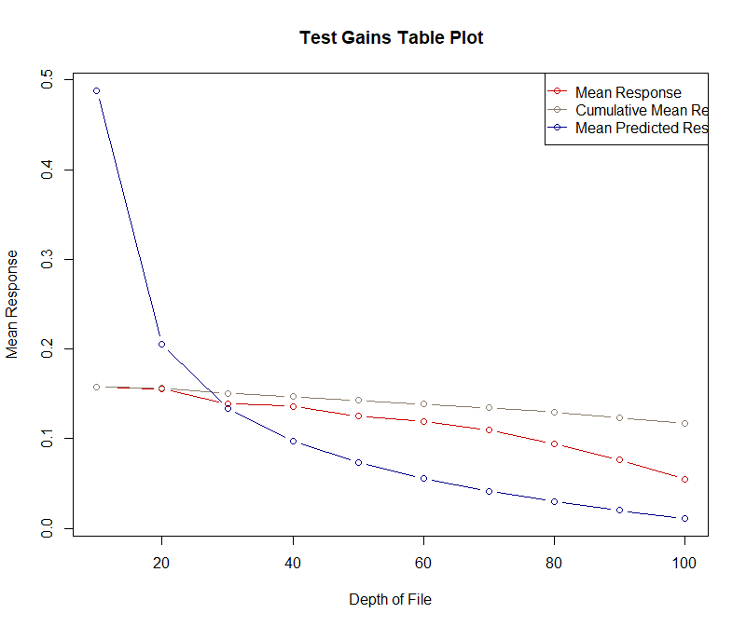
Gains Plot
> # Gain chart for mean predicted
> # response.
> plot(bank.gains$mean.
prediction,type="o")
> # Gain chart for mean response
> plot(bank.gains$mean.resp,type="o")

Slide 13
Gains Table
> bank.pred<-predict(bank.model2, newdata = bank_test, type="response")
> bank.gains<-gains(actual=bank.model$fitted.values, predicted=bank.pred, optimal=TRUE)
> bank.gains
Depth Cume Cume Pct Optimal Optimal Mean
of Cume Mean Mean of Total Lift Cume Lift Cume Model
File N N Resp Resp Resp Index Lift Index Lift Score
-----------------------------------------------------------------------------------------
10 2261 2261 0.16 0.16 13.5% 135 135 445 445 0.49
20 2260 4521 0.16 0.16 26.8% 133 134 185 315 0.21
30 2260 6781 0.14 0.15 38.7% 119 129 117 249 0.13
40 2262 9043 0.14 0.15 50.4% 116 126 81 207 0.10
50 2260 11303 0.13 0.14 61.1% 107 122 59 177 0.07
60 2260 13563 0.12 0.14 71.3% 102 119 43 155 0.06
70 2260 15823 0.11 0.13 80.7% 94 115 31 137 0.04
80 2261 18084 0.09 0.13 88.8% 81 111 21 123 0.03
90 2260 20344 0.08 0.12 95.3% 65 106 13 110 0.02
100 2261 22605 0.05 0.12 100.0% 47 100 6 100 0.01

Slide 14

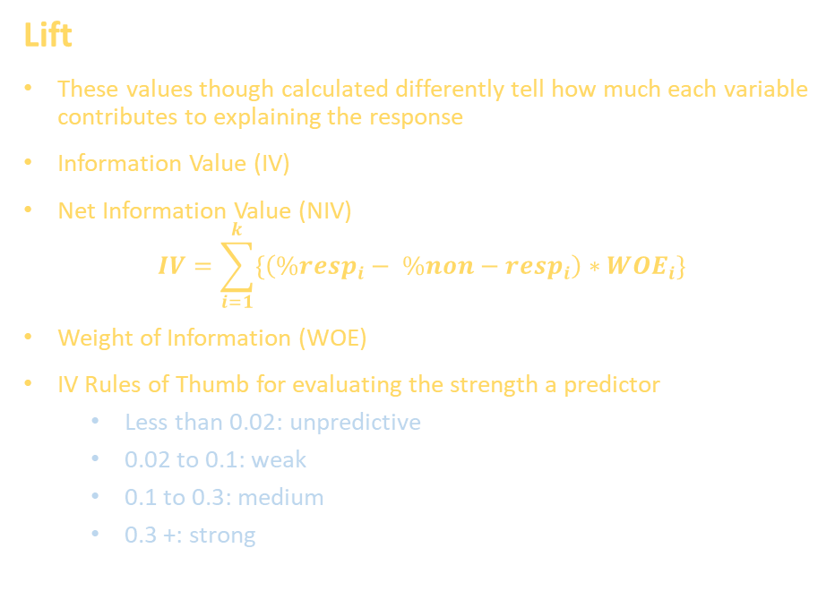
Net Information Value
Based on Communication Theory
With information rich data, we may have a few 100 up to a couple of thousand variables of interest. Two information value metrics can be used for data reduction. Each requires that all numerical variables be equally binned.
Lift
These values though calculated differently tell how much each variable contributes to explaining the response
Information Value (IV)
Net Information Value (NIV)
$$IV=\sum_{i=1}^{k}{\left\{\left(\%resp_{i}− \%non−resp_{i}\right)∗WOE_{i}\right\}}$$
Weight of Information (WOE)
IV Rules of Thumb for evaluating the strength a predictor
Less than 0.02: unpredictive
0.02 to 0.1: weak
0.1 to 0.3: medium
0.3 +: strong
Net Lift
NIV is formed by creating bins for interval input variables for equal comparisons.
$WOE=\left(\frac{\%resp_{i}}{\%non−resp_{i}}\right), i=1,2,…,k where k is the number of bins$
Net WOE (NWOE) is computed by
$NWOE_{attribute}= WOE_{attribute}\left(TREATMENT\right)−WOE_{attribute}\left(CONTROL\right)$
NIV is computed by
$NIV = \sum{\left(\begin{aligned}(P(X=x|resp=1,T)P(X=x|resp=0,C) \\ −P(X=x|resp=0,T)P(X=x|resp=1,C) )x NWOE)\end{aligned}\right)}$

Slide 15
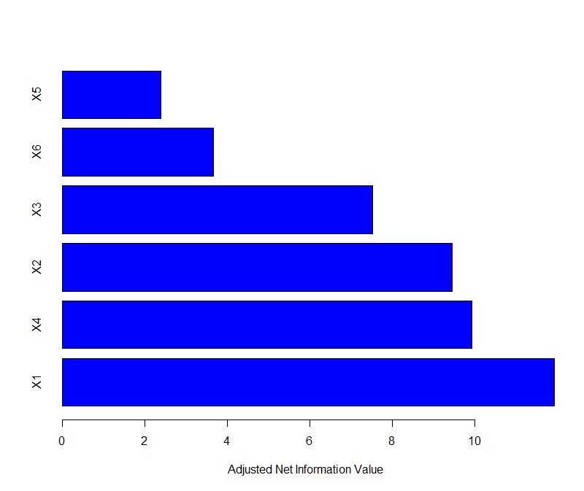
NIV (uplift Package)
> set.seed(12345)
> dd <- sim_pte(n = 1000, p = 20,
rho = 0, sigma = sqrt(2),
beta.den = 4)
> dd$treat <- ifelse(dd$treat == 1, 1, 0)
> niv.1 <- niv(y ~ X1 + X2 + X3 + X4 + X5 +
X6 + trt(treat), data = dd)
> niv.1$niv
niv penalty adj_niv
X1 11.931 0.8733 11.0577
X2 9.444 0.7072 8.7368
X3 7.521 0.4217 7.0993
X4 9.929 0.6240 9.3050
X5 2.388 0.2023 2.1857
X6 3.660 0.4386 3.2214
> niv.1$nwoe
Adjusted IV
Less than 0.2: unpredictive
0.2 to 1.0: weak
1.0 to 3.0: medium
3.0 +: strong

Slide 16
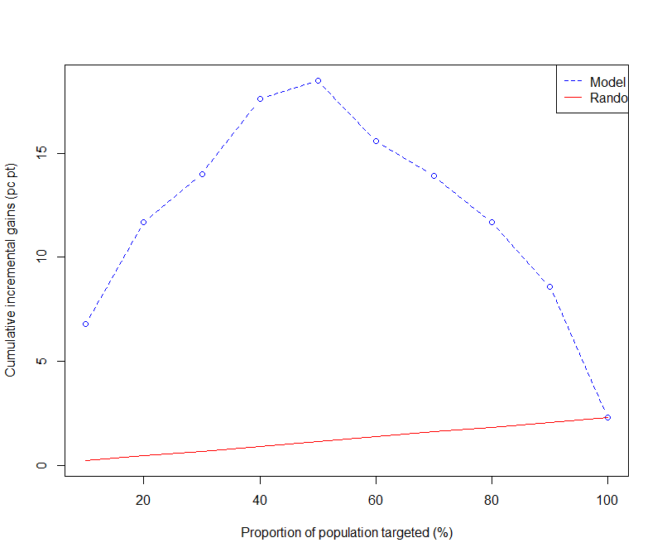
Qini Coefficient: Q
> perf <- performance(pred[, 1], pred[, 2],
dd_new$y, dd_new$treat, direction = 1)
> ### compute Qini coefficient
> Q <- qini(perf, plotit = TRUE)
> Q
$`Qini`
[1] 0.104765
$inc.gains
[1] 0.068 0.117 0.140 0.176 0.185 0.156
[7] 0.139 0.117 0.086 0.023
$random.inc.gains
[1] 0.0023 0.0046 0.0069 0.0092 0.0115
[7] 0.0138 0.0161 0.0184 0.0207 0.0230

Slide 17
www.humalytica.com
http://www.amazon.com/Jeffrey-Strickland/e/B00IQ69QZK/
http://www.lulu.com/spotlight/strickland_jeffrey

